Slide 1

MODEL OF
INTERVENTIONS TO TEEN MOTHERS
* Names changed to protect identities

Slide 2
WHY SUPPORTING TEEN MOTHERS ?
Hope and Homes for Children (HHC) is committed to eliminating child institutionalization.
The core mission: To be the catalyst for the global elimination of institutional care for children.
Support for Teen Mothers:
HHC extends support to teen mothers to prevent the institutionalization of their children.
By aiding teen mothers, HHC strengthens families at risk of separation.
Advocacy and Reform:
HHC advocates for child care reform.
They collaborate with the government to ensure children’s right to a loving and safe family environment.

Slide 3
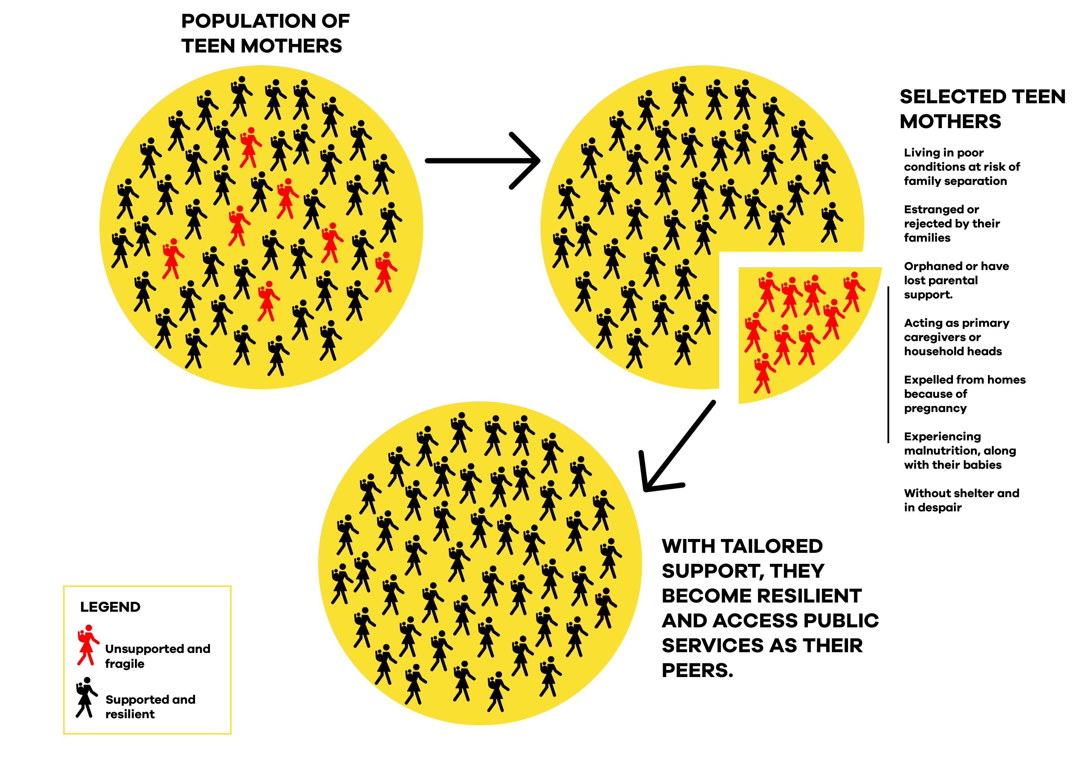
SELECTION CRITERIA
AMONG TEEN MOTHERS, HOPE AND HOMES FOR CHILDREN SUPPORTS THE MOST VULNERABLE

Slide 4
LOCAL LEADERS INVOLVEMENT
Role of Community Volunteers and local leaders
Conduct home visits to: Evaluate well-being, Identify additional support requirements.
Facilitate connections to community resources.
Champion empathy and combat discrimination faced by teen mothers.
Identify families at high risk of separation.
Address conflicts due to pregnancy.
Support those ostracized by their families.
Assist teen mothers under precarious conditions.
Raise awareness about teen mothers’ challenges.
Promote messages against discrimination.
TRAINING LOCAL LEADERS AND COMMUNITY VOLUNTEERS
Identifying at-risk teen mothers.
Understanding their unique needs and rights.
Imparting knowledge on child rights, healthcare access, and birth registration.

Slide 5
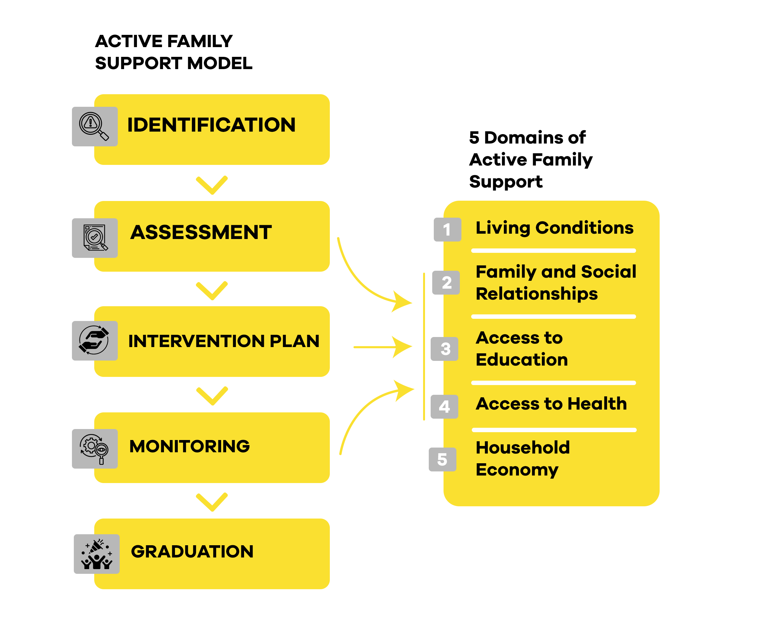
ACTIVE FAMILY SUPPORT ADAPTED TO SUPPORT TEEN MOTHERS

Slide 6
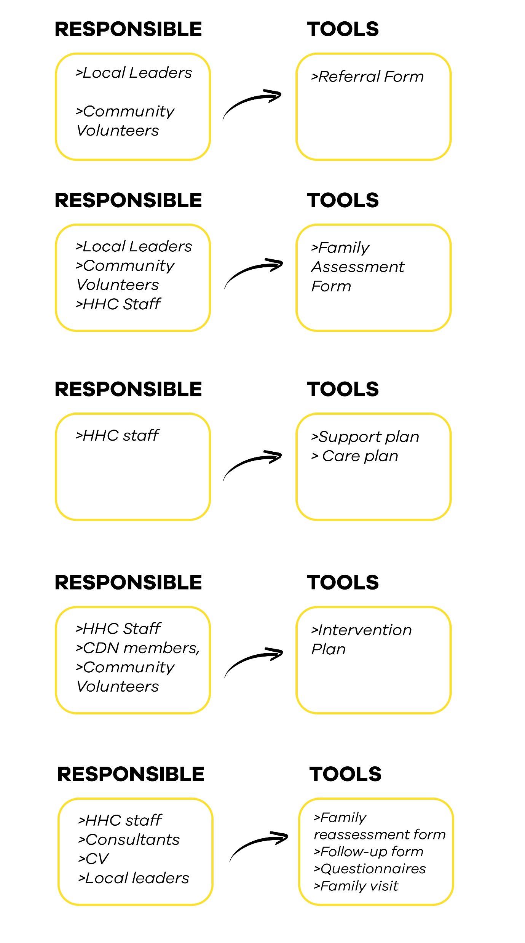
IDENTIFICATION
Empowering Community Involvement: Supporting Teen Mothers
Identifying at-risk teen mothers.
Understanding their unique needs and rights.
Educating families on child rights, healthcare access, and birth registration.

Slide 7
Assessment
Purpose: Gather insights into teen mothers and their families.
Domains Evaluated:
Living conditions.
Family and social relationships.
Education.
Physical and mental health.
Household economy.

Slide 8
INTERVENTION PLAN
Assessment: Thoroughly evaluated teen mothers’ situation, strengths, and needs.

Slide 9
INTERVENTION
IMPLIMENTATION
Addressed living conditions, education, health, family relationships, and household economy.
Collaborated with local CDN and community volunteers

Slide 10
MONITORING
Monitoring, Evaluation, and Learning at HHC
Real-Time Insights:
Planned visits to teen mothers’ homes, training fields, and workplaces.
Accurate understanding of living conditions, family relationships, education access, health, and household economy.
Longitudinal Study:
Baseline, mid-term, and final evaluations.
Holistic and dynamic approach for continuous improvement and effective support.

Slide 11

GRADUATION (CASE CLOSURE)
Throughout the process, graduation is anticipated with a clear perspective on implementing the intervention plan aimed at bringing teen mothers and their families to self-reliance. It is at this stage where the case management is closed after ethical considerations.

Slide 12

KEY LESSON LEARNT
Holistic Approach is Essential
Community Involvement and Collaboration
Importance of Psychosocial Support
Tailored Interventions
The power of participation in education and economic Empowerment
Stigma Reduction and Community Awareness
Sustainability and Scalability

Slide 13
THANKS

