Slide 1

Costing the Changing the Way We Care Kafaalah and Case Management Scaling Models

Slide 2




Outline: Costing the Kafaalah Scaling Model
Methodology for Costing the Kafaalah Scaling Model
Structure of the Costing Tool
Baseline Costing Results
Developing a Costed Implementation Plan

Slide 3
Outline: Costing the Kafaalah Scaling Model
Methodology for Costing the Kafaalah Scaling Model
Structure of the Costing Tool
Baseline Costing Results
Developing a Costed Implementation Plan

Slide 4
Methodology: Scope of the Costing
Legislation, Policy and Coordination
Social Service Workforce
Social Norms and Practices
Monitoring, Evaluation and Evidence Use
Service Delivery

Slide 5
Methodology: Costing Approach
Activity-based costing:
Cost of Activity = Quantity x Input_{n} x Price_{n}
Where

Slide 6






Define the scope of the costing exercise in consultation with the CTWWC Kenya team
Gather information related to the activities involved, the inputs required, the price of the inputs and the relevant quantities supplied.
The Costing Process
Develop a customizable Excel-based costing tool based on historical cost data.
Prepare advocacy messages to accompany the costing tool.
Present the costing tool and report for validation, then finalize the costing documents.
Notes:
Steps 1 to 4 are completed
And we are now on step 5

Slide 7

Outline: Costing the Kafaalah Scaling Model
Methodology for Costing the Kafaalah Scaling Model
Structure of the Costing Tool
Baseline Costing Results
Developing a Costed Implementation Plan

Slide 8

Structure of the Costing Tool
Introductory Sheets
Summary Output
Main Costing Sheets
Costing Assumptions
Title
Readme
Summary
1. Legislation & Policy
2. Social Service Workforce
3. Social Norms and Practices
4. Monitoring & Evaluation
Assumptions
General information regarding the costing tool
Summarizes the costing results by strategic area
Include or exclude activities, specify inputs, prices and quantities, and calculate the costs
Assumptions that apply across the main costing sheets
Notes:
Excel document

Slide 9
Classification of Costing Results

Slide 10
Specifying costing inputs, prices and quantities

Slide 11
Costing Template USD
Costing Template KES

Slide 12
General Cost Assumptions

Slide 13

Outline: Costing the Kafaalah Scaling Model
Methodology for Costing the Kafaalah Scaling Model
Structure of the Costing Tool
Baseline Costing Results
Developing a Costed Implementation Plan

Slide 14
Disclaimer
PLEASE NOTE: Costs within the costing tool are based on historical financial data from CTWWC as it relates to its work on Kafaalah and Case Management for Reintegration. These are the initial costing results that a new user of the costing tool will see upon first opening an original version of the tool. However, due to the proprietary nature of this financial information, these costs are not displayed or analyzed in detail in this report. Any costs shown in this report are used solely for illustrative purposes. To access the tool for your own costing exercise, please contact CTWWC directly.

Slide 15
Overall Costing Result
Notes:
For purposes of our discussion

Slide 16
Summary by Strategic Area
Notes:
For purposes of our discussion

Slide 17

Outline: Costing the Kafaalah Scaling Model
Methodology for Costing the Kafaalah Scaling Model
Structure of the Costing Tool
Baseline Costing Results
Developing a Costed Implementation Plan

Slide 18
Developing a costed implementation plan

Slide 19
Any Questions?

Slide 20
Outline: Costing the Case Management Scaling Model
Methodology for Costing the Case Management Scaling Model
Structure of the CM Costing Tool
Costing Results

Slide 21
Outline: Costing the Case Management Scaling Model
Methodology for Costing the Case Management Scaling Model
Structure of the CM Costing Tool
Costing Results

Slide 22
Methodology: Scope of the Costing
Leverages financial data from CTWWC's initiatives in three demonstration counties to establish a baseline for cost estimation.
By analysing this baseline data, the tool can project the necessary financial resources required to replicate these services in other counties in Kenya.

Slide 23
Methodology: Costing Approach
CM costing tool uses a conventional financial statement costing methodology.
Comprehensive estimation of:
Staff costs,
Direct project activity costs,
Overhead costs, and
Capital costs.

Slide 24
Define the scope of the costing exercise in consultation with the CTWWC Kenya team
Gather information related to the activities involved, the inputs required, the price of the inputs and the relevant quantities supplied.
The Costing Process
Develop a customizable Excel-based costing tool based on historical cost data.
Prepare advocacy messages to accompany the costing tool.
Present the costing tool and report for validation, then finalize the costing documents.

Slide 25
Outline: Costing the Case Management Scaling Model
Methodology for Costing the Case Management Scaling Model
Structure of the CM Costing Tool
Costing Results

Slide 26
Structure of the Costing Tool
Introductory Sheets
Costing Summary
Main Costing Sheets
Data Sheet
Costing Assumptions
Title
Readme
Summary
Country Allocation
Budget Data
GenAssumptions
general information regarding the costing tool
summarizes the costing results
horizontal and vertical allocation of costs
include or exclude activities, specify inputs, prices and quantities, and calculate the costs
assumptions that apply across the main costing sheets

Slide 27
Cost Classification in the CM Costing Tool

Slide 28
Specifying Unit Costs & Quantities

Slide 29
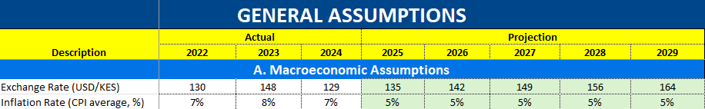
General Cost Assumptions
Source: Central Bank of Kenya, National Treasury (2024) Budget Policy Statement, FX rate projections deflated by CPI

Slide 30
Operating and Capital Cost Assumptions

Slide 31
Cost Allocation: Horizontal and Vertical Allocation

Slide 32
Outline - Costing the CM Scaling Model
Methodology for Costing the Case Management Scaling Model
Structure of the CM Costing Tool
Costing Results

Slide 33
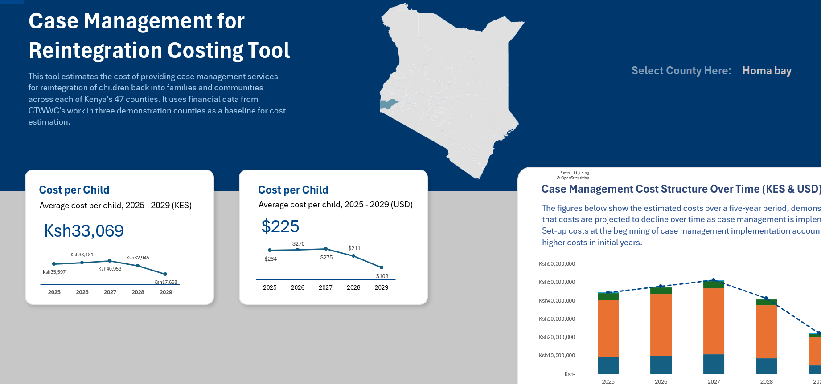
Costing Summary

Slide 34
Any Questions?

Slide 35


Global Evidence on Care
Meta-analysis of 300+ studies: Suboptimal residential care harms children's well-being.
Advocacy Messages
Family-based care promotes better development and public health outcomes.
Residential care is NOT cost-effective, costing 6-10 times more than family-based alternatives without corresponding benefits.
CTWWC Initiatives in Kenya
Significant number of children in residential care.
CTWWC developed costing tools to estimate costs of scaling Kafaalah model and case management for reintegration, based on demonstration work.
Not only do tools provide evidence on the cost of these family and community-based care options, basis for cost-effectiveness and cost-benefit analyses to strengthen evidence base.
Source: IJzendoorn et al. (2020), CDC (2021)
Notes:
A comprehensive meta-analysis comprising more than 300 studies worldwide shows that bringing up children in suboptimal residential care environments is harmful to their well-being. In contrast, there is robust evidence that nurturing family-based care promotes better development outcomes for children and overall public health.
In Kenya, a significant number of children are still brought up in residential care. The financial implications of continuing on this trajectory are significant. Residential care has been shown to be cost-ineffective. Estimates suggest that it can cost six to ten times as much as family and community-based alternatives, without the corresponding benefits. This stark difference underscores the urgent need to redirect funding towards more sustainable and beneficial care options like those proposed by CTWWC.
To aid this transition, CTWWC has developed two costing tools based on the demonstration work completed in three counties. These tools are designed to estimate the costs of scaling the Kafaalah model and the case management approach to reintegration. By leveraging historical financial data from CTWWC operations, these tools provide a customizable platform that allows stakeholders to project the costs of implementing these models in various regions.
Utilizing these tools, stakeholders can generate concrete evidence on the costs of the two scaling models. This evidence is crucial in advocating for investment in more nurturing, family-and community-based care. These estimates can also potentially form the basis of subsequent cost-effectiveness and cost-benefit analyses, further strengthening the evidence base.
Marinus H. van IJzendoorn et al., ‘Institutionalisation and Deinstitutionalisation of Children 1: A Systematic and Integrative Review of Evidence Regarding Effects on Development’, The Lancet Psychiatry 7, no. 8 (1 August 2020): 703–20, https://doi.org/10.1016/S2215-0366(19)30399-2.
Centers for Disease Control and Prevention, ‘Essentials for Childhood - Creating Safe, Stable, Nurturing Relationships and Environments for All Children’, 2021.
IJzendoorn et al., ‘Institutionalisation and Deinstitutionalisation of Children 1’.

Slide 36
Thank you
Need to know more? Contact Changing the Way We Care at info@ctwwc.org or visit www.changingthewaywecare.org.
Changing The Way We Care℠ (CTWWC) is implemented by Catholic Relief Services and Maestral International, along with other global, national, and local partners working together to change the way we care for children around the world. Our principal global partners are the Better Care Network and Faith to Action. CTWWC is currently funded in part by Catholic Relief Services and the GHR Foundation.
© 2025 [Catholic Relief Services or, in some cases, Maestral International]. All Rights Reserved. This material may not be reproduced, displayed, modified or distributed without the express prior written permission of the copyright holder. For permission, write to info@ctwwc.org. The photographs in this publication are used for illustrative purposes only; they do not imply any particular health, orphanhood, or residential care status on the part of any person who appears in the photographs.
Catholic Relief Services | 228 W. Lexington Street, Baltimore, MD, 21201, USA | crs.org | crsespanol.org
Maestral International | maestral.org

