Slide 1

Primary Prevention in the Programme Management Cycle

Slide 2
Overall Aim
To strengthen participants’ overall understanding of prevention in child protection in humanitarian action and introduce the principles and steps involved.

Slide 3
Learning Objectives
By the end of the learning journey, participants will be able to:
Define prevention in child protection in humanitarian action
Discuss the nine guiding principles for CPHA prevention programming
Explain the key steps for primary prevention in the program management cycle and give examples of how these may be applicable in own context
Describe opportunities and challenges associated with prevention programming in child protection in humanitarian action

Slide 4
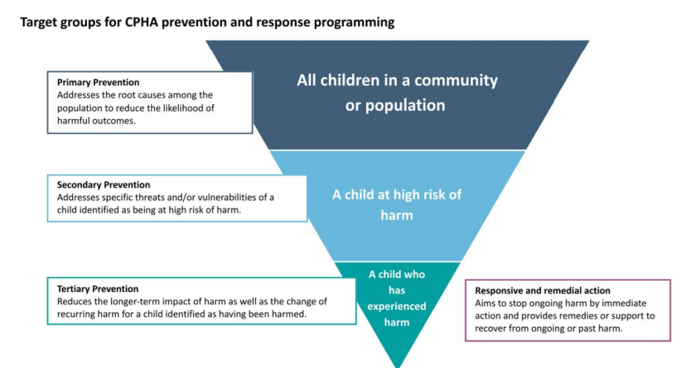

Slide 5
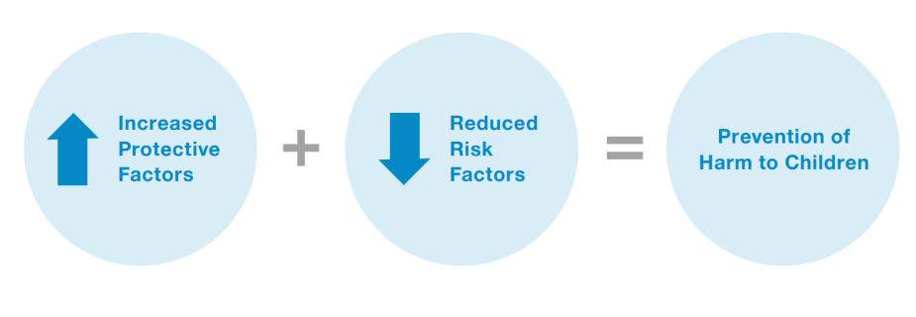
Notes:
A primary preventive approach is one that seeks to strengthen protective factors and mitigate risk factors at a population level in order to prevent harm to children. The below diagram provides a visual depiction of this.

Slide 6
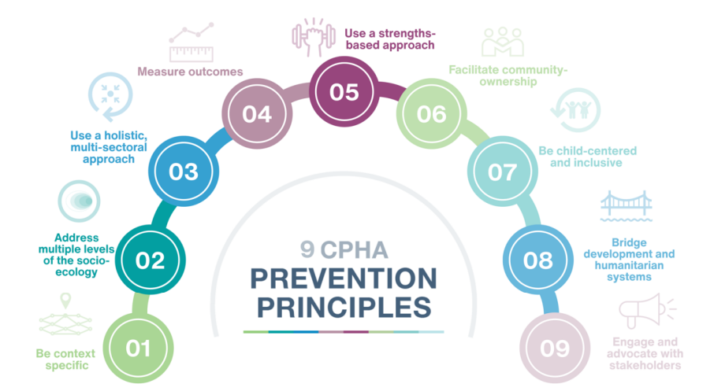

Slide 7
What are the Programme Management Cycle Steps?

Slide 8
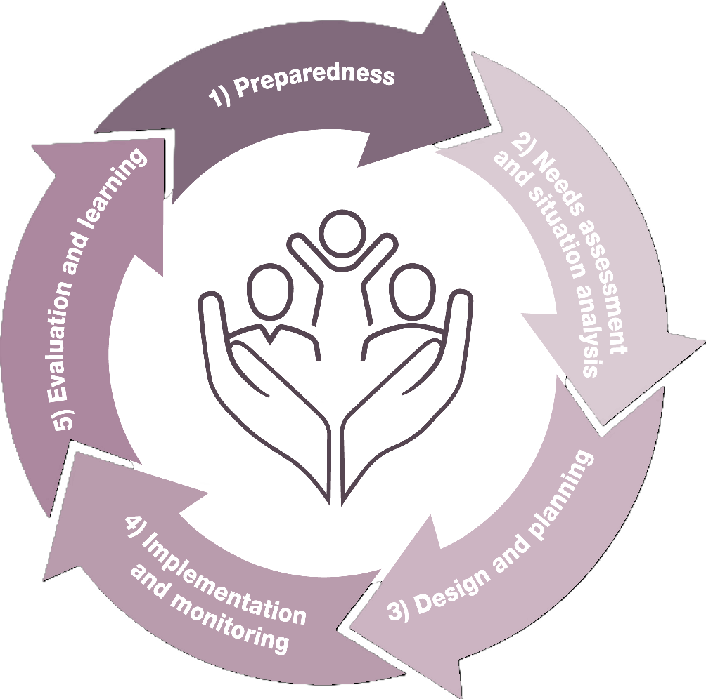
What are the Programme Management Cycle Steps?

Slide 9
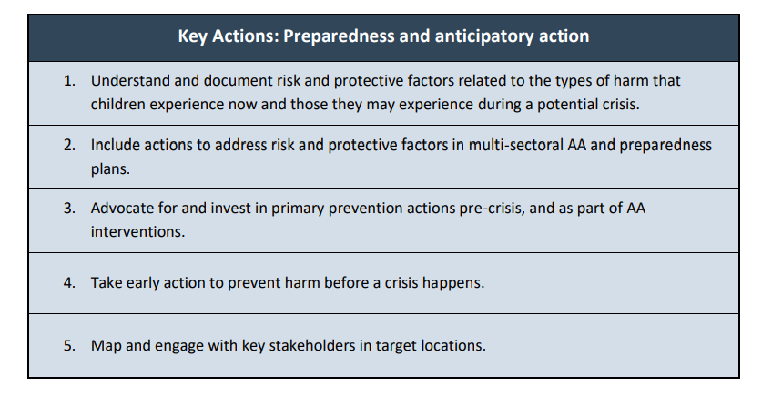
Step 1
Preparedness and Anticipatory Action
Notes:
Emergency preparedness is the activities and measures taken before a crisis to ensure a rapid and
effective response.

Slide 10
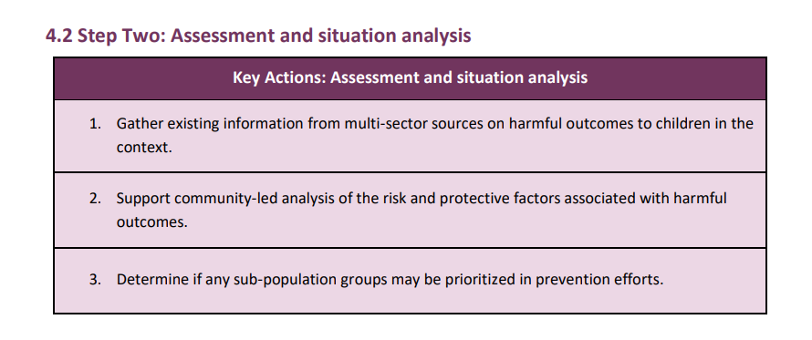
Step 2
Assessment and Situation Analysis
Notes:
A primary prevention approach is based on a comprehensive analysis of the risk and protective
factors that impact whether children experience harmful outcomes. It goes beyond the question
of “What are the harmful outcomes to children occurring in this context?” (e.g., child marriage,
violence in schools, recruitment in armed forces, family separation). Prevention programming also
needs to know:
• “What are the risk factors leading to harmful outcomes for children?” and
• “What are the protective factors that can prevent children from experiencing harmful outcomes?”17

Slide 11
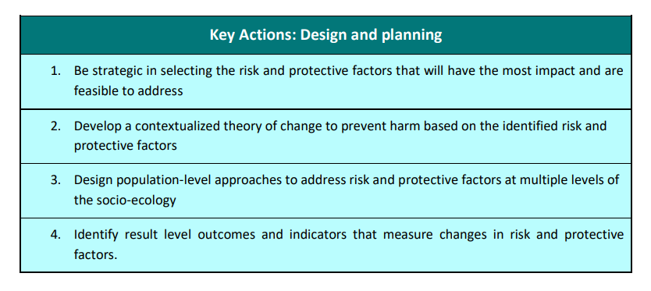
Step 3
Design and Planning

Slide 12
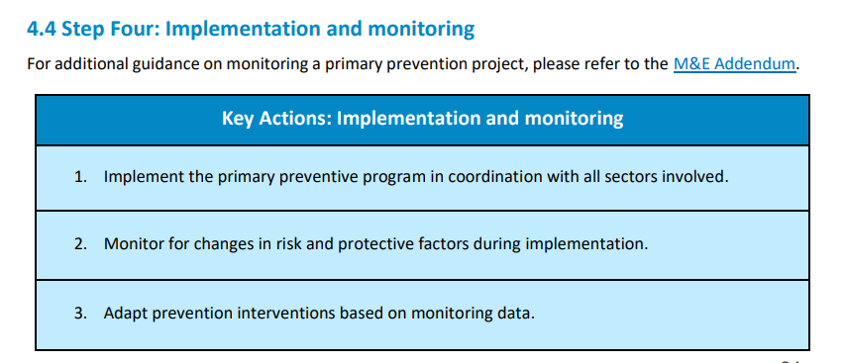
Step 4
Implementation and Monitoring

Slide 13
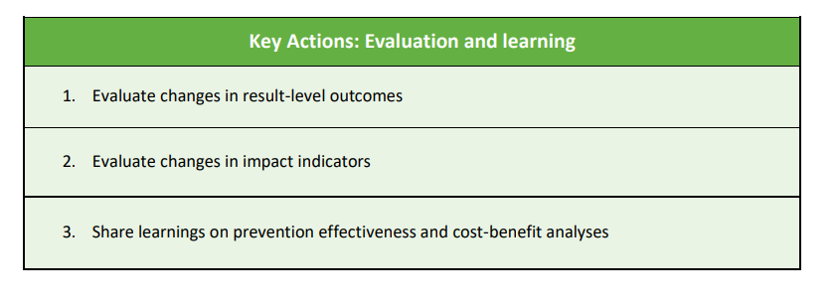
Step 5
Evaluation and Learning

Slide 14
Annexes and Complementary Resources
Primary Prevention Framework - Monitoring and Evaluation Addendum [English]
Annex 1: Examples of Common Risk and Protective Factors [English]
Annex 2: Suggested Actions to Integrate the Prevention Principles into the Program Cycle [English]
Annex 3: Example Logical Framework for a Primary Prevention CPHA Program [English]
Annex 4: Risk and Protective Factor Prioritisation Tool [English]
Notes:
Primary Prevention Framework – Monitoring and Evaluation Addendum: This M&E Addendum is a companion to the PPF, addressing the unique challenges of monitoring and evaluating primary preventative approaches in humanitarian settings, which emphasizes identifying and addressing risk and protective factors to avert harmful outcomes for children before they occur. This addendum provides practical guidance on monitoring and evaluating the success of primary prevention. It also refers humanitarian actors, where possible, to standard tools and methodologies to measure progress and adapt interventions.
Annex 1: Examples of common risk and protective factors This annex provides examples of common risk and protective factors across the socio-ecological model and is a key tool when providing training on primary prevention. It can also be used during the Assessment and Situation Analysis phase of the program management cycle to support analysis and reporting of the results of the Risk and Protective Factor Ranking Exercise.
Annex 2: Suggested actions to integrate the prevention principles into the program cycle This annex provides guidance on how to integrate the nine key prevention principles into each step of the program cycle. It should be consulted throughout each step of the program cycle to ensure primary prevention approaches are aligned with prevention principles. This annex also provides links and references to additional supporting material, where relevant.
Annex 3: Example logical framework for a primary prevention CPHA program This annex is a simple logical framework for a primary prevention program seeking to prevent the recruitment of children by armed groups. It includes sample activities, indicators and outcomes. This can be used as a guide for developing a logical framework for a primary preventive approach, or as a tool during trainings to illustrate a primary prevention approach.
Annex 4: Risk and protective factor prioritization tool This tool facilitates the prioritization of risk and protective factors identified in a given context. It allows teams to narrow down the number of risk and protective factors to focus on in a primary preventive approach, based on the following criteria: impact, feasibility, and intersection with multiple types of harm. The resulting prioritized risk and protective factors will then inform program design.

Slide 15
Annexes and Complementary Resources Cont
Annex 5: Summary of Evidence-based CPHA Prevention Approaches [English]
Annex 6: One-pager on 'What is Primary Prevention' for Multi-sectoral Actors [English]
Annex 7: Orientation Session for External Stakeholders [English]
Annex 8: Primary Prevention Design Flowchart
Annex 9: Monitoring and Evaluation Framework [English]
Annex 10: Key Advocacy Messages [English]
Notes:
Annex 5: Summary of evidence-based CPHA prevention approaches This annex suggests evidence-based approaches for addressing risk factors and preventing harmful outcomes. The evidence base for these activities can be found in the “Prevention Framework: Desk Review Synthesis.” The annex is organized according to the socio-ecological model, providing several examples of interventions and activities per level. The annex also draws linkages with existing resources.
Annex 6: One pager on what is primary prevention for multi sectoral actors This annex provides a short explanation of primary prevention and why it is important for other humanitarian sectors. It is useful for CPHA practitioners to know how to better engage with colleagues from other sectors, and for other sectors to understand why their contribution is critical to implement primary prevention approaches and reduce harmful outcomes.
Annex 7: Orientation session for external stakeholders This annex is a short presentation targeting various audiences, including coordination groups (interagency working groups, clusters etc.) as well as internal stakeholders (country management teams) and external stakeholders (other NGO actors and government actors). It outlines the importance of primary prevention, guiding principles and key terminology.
Annex 8: Primary prevention design flowchart This annex is a visual depiction of the process one should follow to move from selecting a harmful outcome to designing a primary prevention program. It includes the key steps, from identifying a harmful outcome, to identifying and prioritizing risk and protective factors, to crafting a theory of change and designing activities and an M&E framework. Useful guidance and references are included.
Annex 9: Monitoring and evaluation framework The monitoring and evaluation framework includes a sample logical framework with objectives, activities and indicators for a primary preventive approach as well as a monitoring and evaluation plan. It is intended to be used as an illustrative example to support teams in designing primary preventive approaches, as every prevention project must be tailored to the specific context, harmful outcomes, and prioritized risk and protective factors.
Annex 10: Key advocacy messages These advocacy messages can be used by CPHA actors for internal and external advocacy efforts.

Slide 16
Next Steps

